Slide 1
UNIT 5 Curves, fractals and Animation
Syllabus
Curves: Introduction, interpolation and approximation, Spline Interpolation Methods – herm`ite interpolation, Bezier curves, B-Splines.
Fractals: Introduction, Classification, fractal Dimension, Fractal dimension and surfaces, Hilbert curve, Koch Curve.
Animation: Basics of animation, types of animation, principles of animation, design of animation sequences, animation languages, key frame, morphing, motion specification. Methods of controlling animation, frame-by-frame animation techniques, real-time animation techniques.

Slide 2
What is curve?
curve is a set of points or pixels.
Curves are one of the most essential objects to create high resolution objects.
Curves can be stored mush easier, can be scaled to any resolution without losing smoothness, also provide a much easier way to specify real world objects.
All of the popular curves used in computer graphics are specified by parametric equations.
For generation of curves there are two methods,
Use of a curve generation method
Approximate the curve

Slide 3
Curve generation method
In this method, we can use readymade curve generation algorithm to draw a curve such as DDA.
we can also use circle generation algorithm to form different curves.
By using this algorithms we will get the actual curves.
When we are using any circle generation algorithm to draw a curve, at that time we should not draw a complete circle but we should draw only some part of that circle which will act as curve.

Slide 4
2. Approximation
Instead of using readymade algorithm, we are approximating the curve by small straight lines. for this we have to use interpolation technique.
We can draw an approximation to a curve if we have an array of sample points.
The sample points are nothing but some points on the estimated path of the curve.
From these few sample points, we can guess the shape of the curve.
If the sample points are very close to each other then we can easily guess the shape of the curve.

Slide 5
Interpolation
Interpolation is a method of constructing new data points within range of discrete set of known data points.
The number of data points obtained by sampling or experimentation represents values of function for limited number of values of independent variable.
The main task of Interpolation is to find suitable mathematical expression for known curve. This technique is used when we have to draw curve by determining intermediate points between known sample points.
Types of Interpolation methods :
Inverse Distance Weighted (IDW) – In this method, estimation of cell values is done by averaging values of sample data points in neighborhood of each processing cell.
A specified number of points or all points within specified radius can be used to determine output value of each location. The point closer to center of cell have more influence or weight in averaging process.

Slide 6
2. Kriging – Kriging is geostatistical procedure that considers both distance and degree of variations between known data points when estimating values in unknown areas.
3. Natural Neighbor – Natural Neighbour interpolation method finds closest subset of input samples to query point.
4. Spline – In this interpolation method, estimation of values is done using mathematical function that minimizes overall surface curvature and results in smooth surface that passes exactly through input points.
5. Spline with barriers – Spline with barriers method is similar to spline method, only difference is that this tool honors discontinuities encoded in both input barriers and input point data.

Slide 7
6. Topo to raster – This method uses technique specifically designed to create surface that more closely represents natural drainage surface and better preserves stream networks from input contour data.
7. Trend – It is a global polynomial interpolation that fits smooth surface defined by mathematical function (a polynomial) to input sample points.

Slide 8
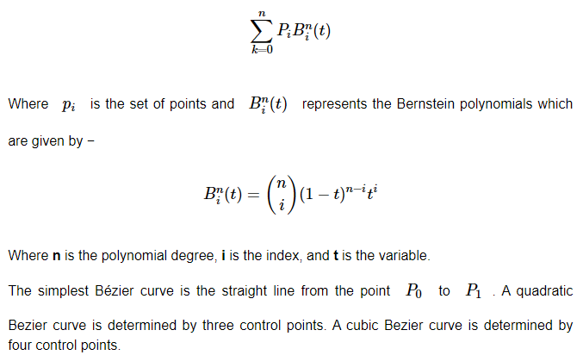
Bezier Curve
Bezier curve is discovered by the French engineer Pierre Bézier. These curves can be generated under the control of other points. Approximate tangents by using control points are used to generate curve. The Bezier curve can be represented mathematically as −

Slide 9
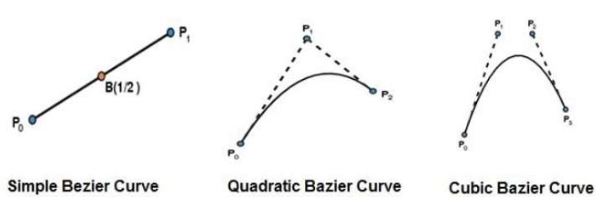

Slide 10
Properties of Bezier Curve
They generally follow the shape of the control polygon, which consists of the segments joining the control points.
They always pass through the first and last control points.
They are contained in the convex hull of their defining control points.
The degree of the polynomial defining the curve segment is one less that the number of defining polygon point. Therefore, for 4 control points, the degree of the polynomial is 3, i.e. cubic polynomial.
A Bezier curve generally follows the shape of the defining polygon.
The direction of the tangent vector at the end points is same as that of the vector determined by first and last segments.
The convex hull property for a Bezier curve ensures that the polynomial smoothly i.e No straight line intersects a Bezier curve more times than it intersects its control polygon.

Slide 11
8. Bezier curves exhibit global control means moving a control point alters the shape of the whole curve.
9. A given Bezier curve can be subdivided at a point t=t0 into two Bezier segments which join together at the point corresponding to the parameter value t=t0.

Slide 12
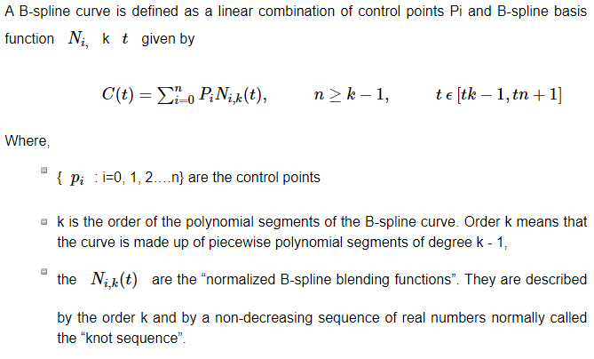
B-Spline Curves
First, the number of specified polygon vertices fixes the order of the resulting polynomial which defines the curve.
The second limiting characteristic is that the value of the blending function is nonzero for all parameter values over the entire curve.

Slide 13
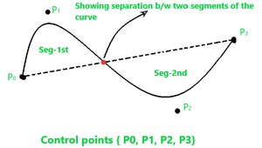
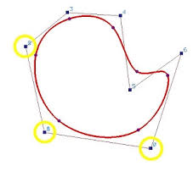
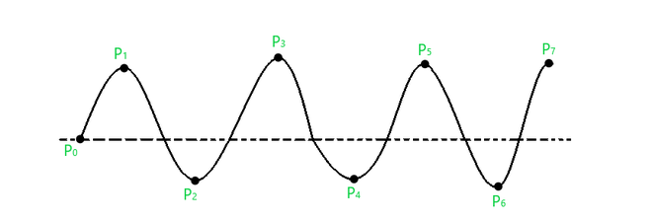

Slide 14
Properties
the sum of the B-spline basis functions for any parameter value is 1.
Each basis function is positive or zero for all parameter values.
Each basis function has precisely one maximum value, except for k=1.
The maximum order of the curve is equal to the number of vertices of defining polygon.
The degree of B-spline polynomial is independent on the number of vertices of defining polygon.
B-spline allows the local control over the curve surface because each vertex affects the shape of a curve only over a range of parameter values where its associated basis function is nonzero.
The curve generally follows the shape of defining polygon.
Any affine transformation can be applied to the curve by applying it to the vertices of defining polygon.

